Slide 1


Tomasz Mulka
05.06.2025

Slide 2

Outline
Executive Summary
Introduction
Methodology
Results
Conclusion
Appendix

Slide 3
Executive Summary
Methodologies Used
Data Collection & Cleaning: Acquired launch records from SpaceX and NASA APIs, cleaned and preprocessed the data.
EDA & Visualization:
Used pandas and seaborn for correlation analysis.
Plotted launch sites and success rates on interactive Folium maps.
Feature Engineering:
Encoded categorical features like launch site, booster version.
Normalized numerical values like payload mass.
Modeling:
Implemented and compared multiple classification models:
Logistic Regression
Support Vector Machine (SVM)
Decision Tree
K-Nearest Neighbors (KNN)
Model Evaluation:
Used metrics like accuracy
Tuned hyperparameters using GridSearchCV.

Slide 4
Introduction
🌍 Project Context
SpaceX offers Falcon 9 launches at a competitive price of $62 million per mission. A key factor in this cost-efficiency is the reusability of the first stage booster. In contrast, other providers can charge upwards of $165 million per launch. Predicting whether the first stage will land successfully is critical for estimating mission costs and enhancing commercial viability.
❓ Problems & Research Questions
Will the Falcon 9 first stage land successfully?
→ Predict landing outcome based on historical launch data.
What factors influence the success of a rocket landing?
→ Explore features such as launch site, payload mass, booster version, and orbit type.
Can we support bidding decisions for alternate providers?
→ Provide actionable insights for organizations competing with SpaceX or planning launches.

Slide 5

Section 1

Slide 6
Data Collection
Describe how data sets were collected.
You need to present your data collection process use key phrases and flowcharts

Slide 7
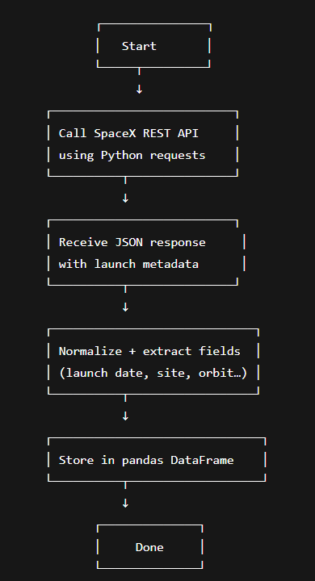
Data Collection – SpaceX API
Main source for launch metadata: booster version, payload mass, orbit.
Link to github with corresponding jupyter notebook:
https://github.com/Tomulll/Space-X---Data-Science-Project/blob/main/Data_Collection_API.ipynb

Slide 8
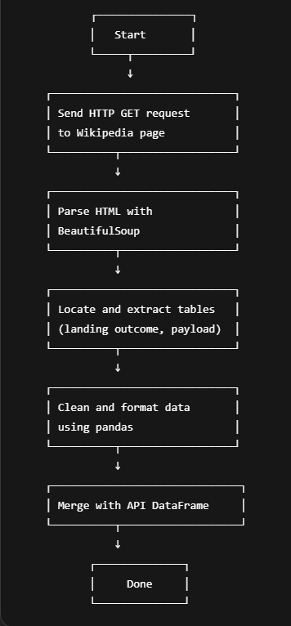
Data Collection - Scraping
Supplementary data: landing outcomes, detailed payload info.
Link to github with corresponding jupyter notebook:
https://github.com/Tomulll/Space-X---Data-Science-Project/blob/main/Webscraping.ipynb

Slide 9
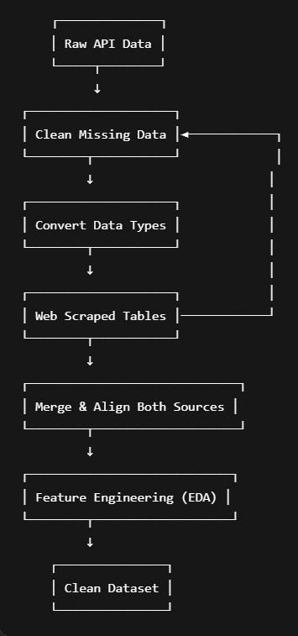
Data Wrangling
Key Processing Steps
Data Cleaning:
Removed null/irrelevant entries (e.g. launches with no payload or outcome).
Replaced None/NaN with proper defaults or removed when necessary.
Data Type Conversion:
Converted timestamp strings to datetime format.
Ensured consistent numeric types for payload mass and flight numbers.
Feature Engineering:
Extracted binary target variable: LandingSuccess (1 = landed, 0 = failed).
Created new categorical variables like LaunchSiteCategory.
Merging Sources:
Merged SpaceX API data and scraped data using FlightNumber and Date.
Aligned schema and resolved format mismatches.

Slide 10
EDA with Data Visualization
Purpose of Exploratory Data Analysis (EDA)
To explore underlying patterns, detect relationships between features, and gain actionable insights to support model selection and feature engineering for predicting Falcon 9 first stage landing success.
Link to github with corresponding jupyter notebook:
https://github.com/Tomulll/Space-X---Data-Science-Project/blob/main/Visualizations.ipynb

Slide 11
EDA with SQL
Insights Discovered via SQL
Certain orbits (like LEO and ISS) had significantly higher success rates.
Some launch sites showed greater consistency in successful landings.
Launch activity and success rate steadily improved each year, confirming learning effects and technological maturity.
Link to github with corresponding jupyter notebook:
https://github.com/Tomulll/Space-X---Data-Science-Project/blob/main/SQL_Lite.ipynb

Slide 12
Build an Interactive Map with Folium
Map Components Created
Markers
Placed at each SpaceX launch site with custom popups showing site name and coordinates.
Helped identify launch location distribution across the U.S.
Circle Markers
Added to highlight proximity to nearby cities and features.
Radius scaled based on payload mass or distance for visual clarity.
Lines (Polylines)
Connected launch sites to nearest major cities.
Visualized potential logistical considerations (e.g., transport or supply paths).
Link to github with corresponding jupyter notebook:
https://github.com/Tomulll/Space-X---Data-Science-Project/blob/main/Launch_Site_Location_Folium.ipynb

Slide 13
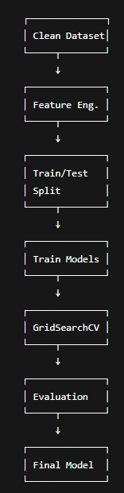
Predictive Analysis (Classification)
To predict the landing success of Falcon 9’s first stage, I trained multiple classification models including Logistic Regression, Decision Tree, SVM, and K-Nearest Neighbors. The dataset was preprocessed with feature selection and one-hot encoding and then split into training and test sets. I performed hyperparameter tuning using GridSearchCV to optimize model performance. Among all models, the Decision Tree Classifier achieved the highest accuracy and interpretability, making it the final choice for deployment.
Link to github with corresponding jupyter notebook:
https://github.com/Tomulll/Space-X---Data-Science-Project/blob/main/Machine_Learning_Predictions.ipynb

Slide 14
Results
Exploratory data analysis revealed that missions to Low Earth Orbit and moderate payload masses had the highest landing success rates. The success rate has also steadily improved over the years, reflecting SpaceX’s growing reliability. An interactive Folium map was created to visualize launch sites and their proximity to key cities, enhancing geographic context. Among the classification models tested, the Decision Tree Classifier achieved the best performance with approximately 85–90% accuracy. Key predictors identified by the model included payload mass, orbit type, and launch site.

Slide 15

Section 2

Slide 16
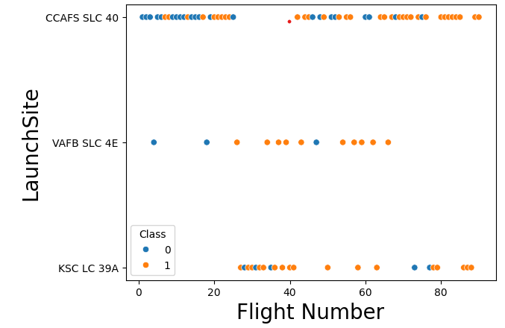
Flight Number vs. Launch Site

Slide 17
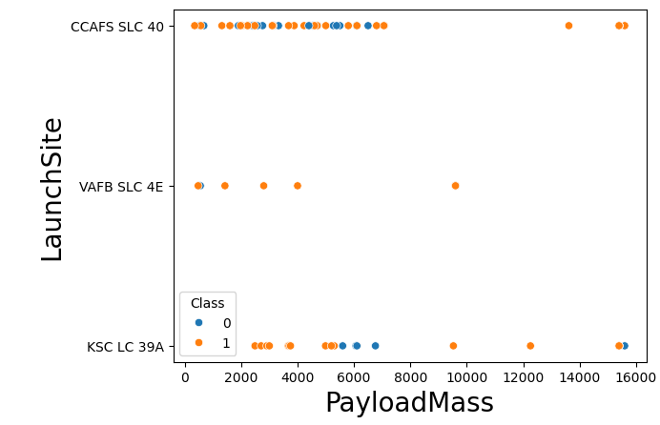
Payload vs. Launch Site

Slide 18
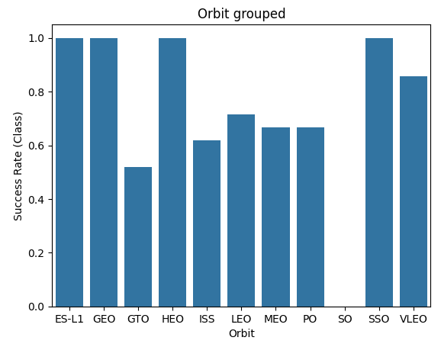
Success Rate vs. Orbit Type

Slide 19
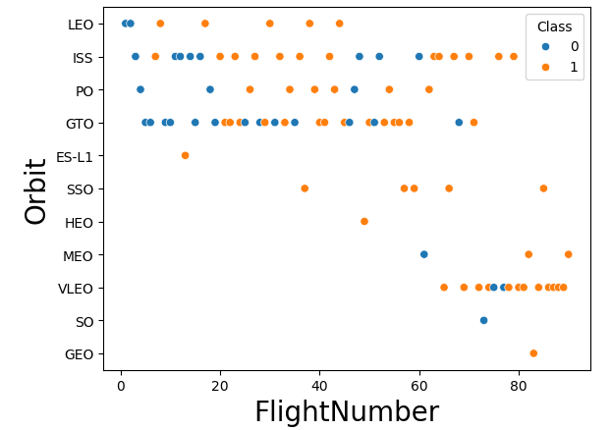
Flight Number vs. Orbit Type

Slide 20
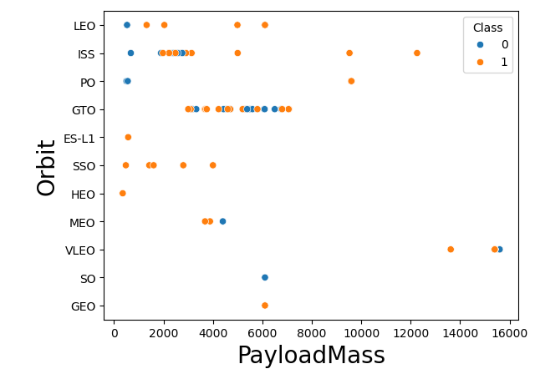
Payload vs. Orbit Type

Slide 21
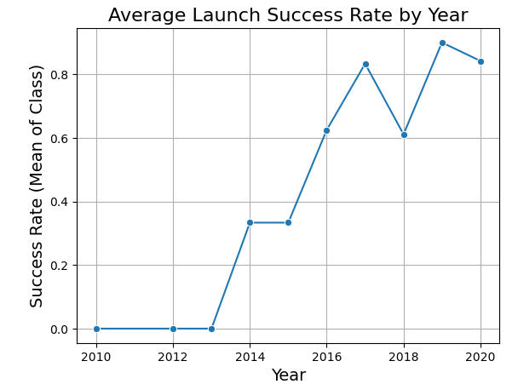
Launch Success Yearly Trend

Slide 22
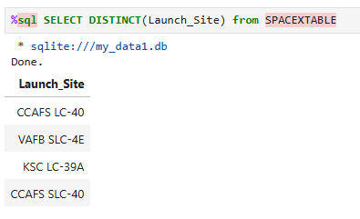
All Launch Site Names

Slide 23
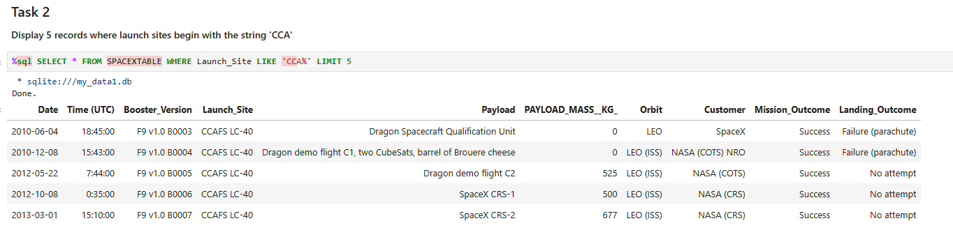
Launch Site Names Begin with 'CCA'

Slide 24
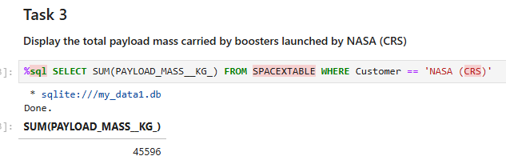
Total Payload Mass

Slide 25
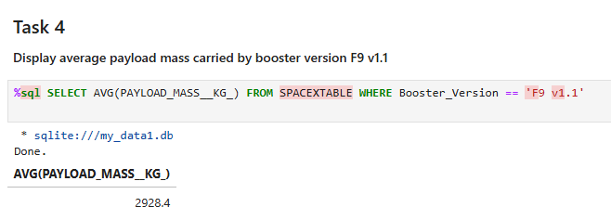
Average Payload Mass by F9 v1.1

Slide 26
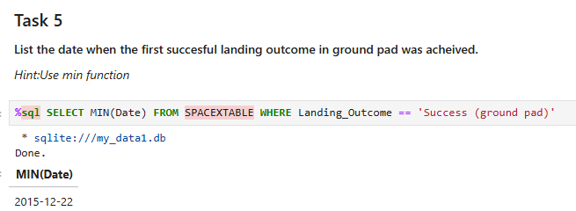
First Successful Ground Landing Date

Slide 27
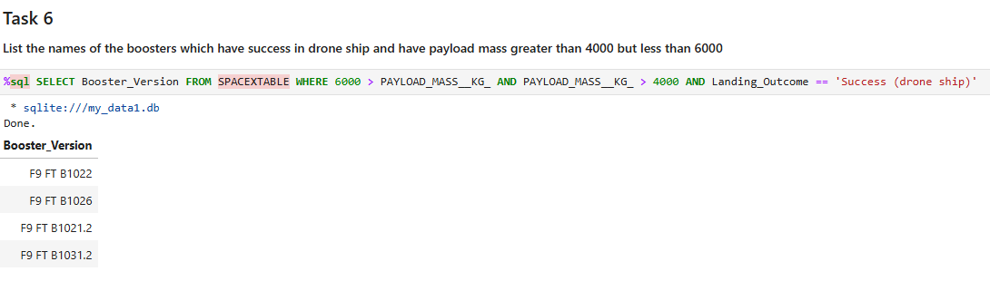
Successful Drone Ship Landing with Payload between 4000 and 6000

Slide 28
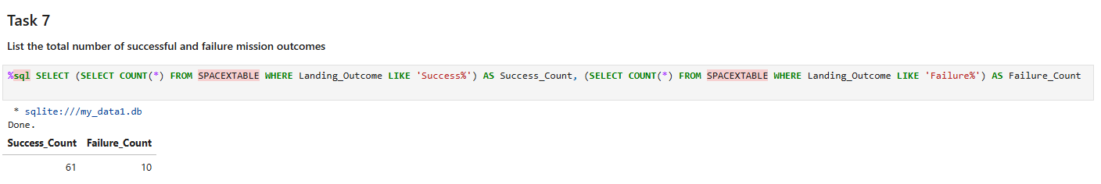
Total Number of Successful and Failure Mission Outcomes

Slide 29
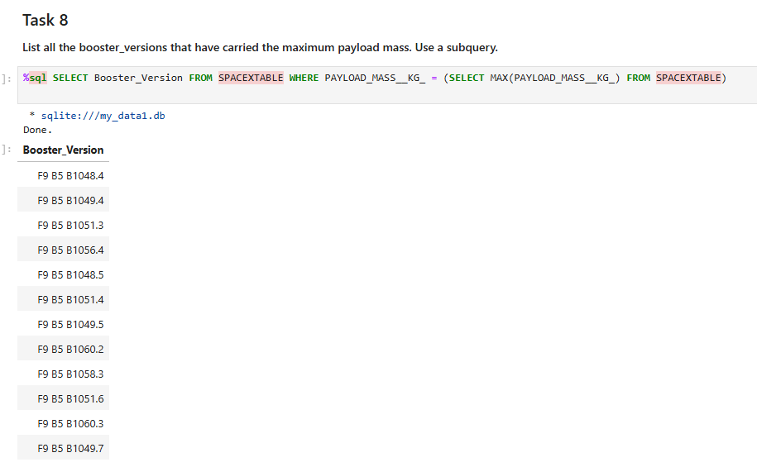
Boosters Carried Maximum Payload

Slide 30
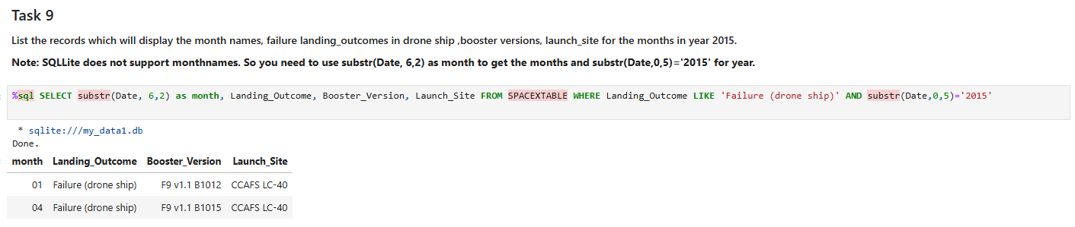
2015 Launch Records

Slide 31
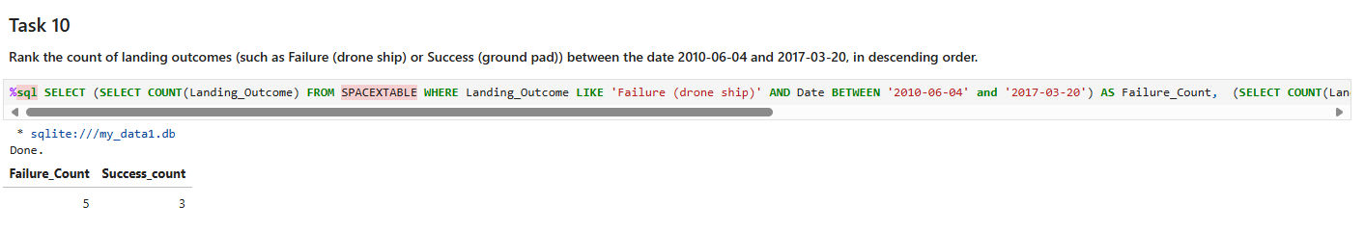
Rank Landing Outcomes Between 2010-06-04 and 2017-03-20

Slide 32

Section 3

Slide 33
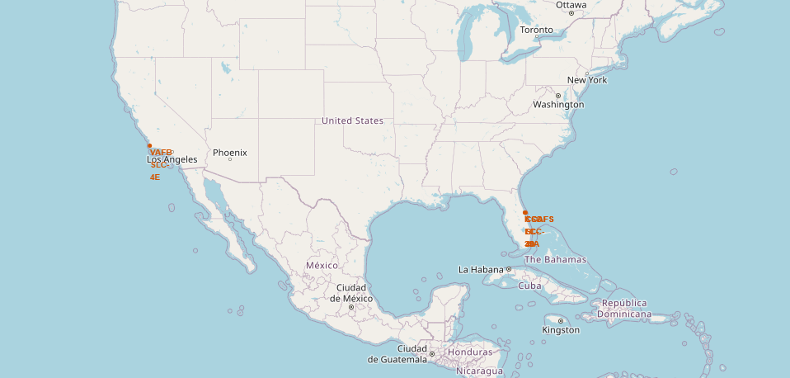
Launch Sites on map by Folium

Slide 34
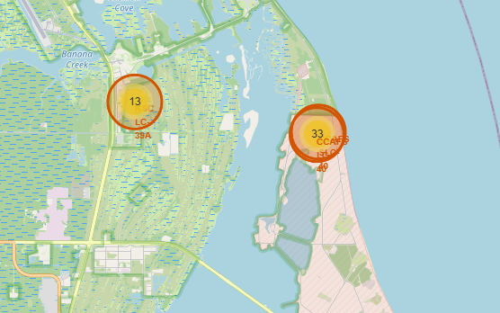
Launch Sites with outcomes/attempts

Slide 35
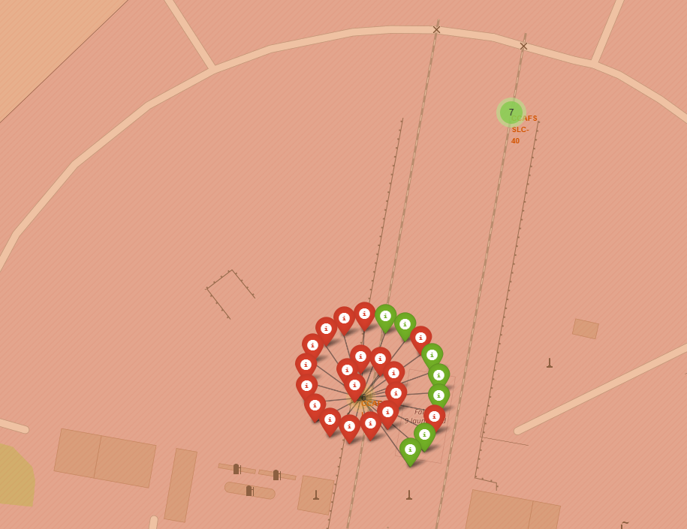
Markers for succesful/failure attempts by Folium

Slide 36

Section 4

Slide 37
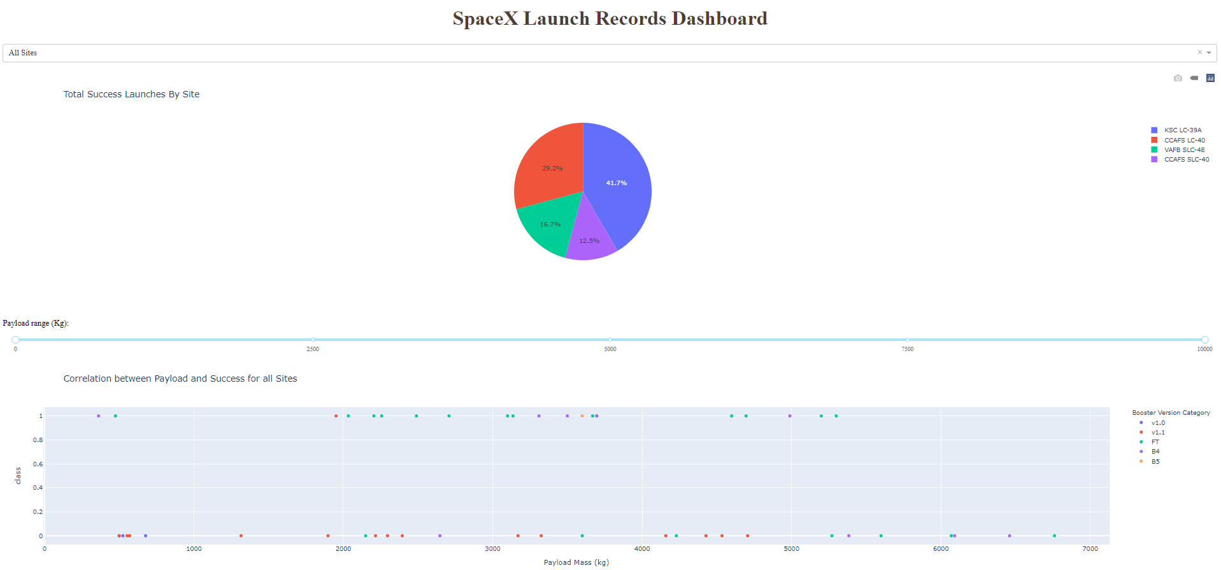
Dashboard by Plotly

Slide 38
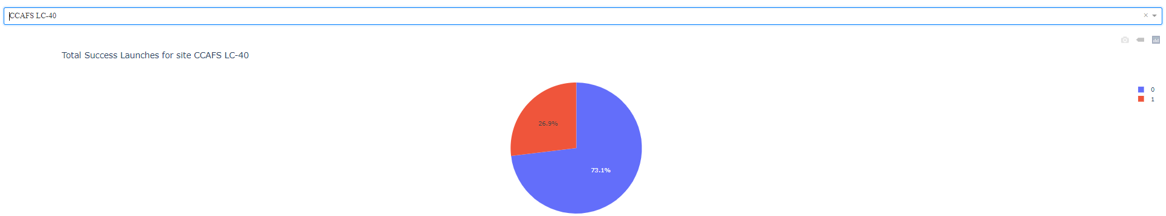
Dashboard - piechart

Slide 39

Section 5

Slide 40
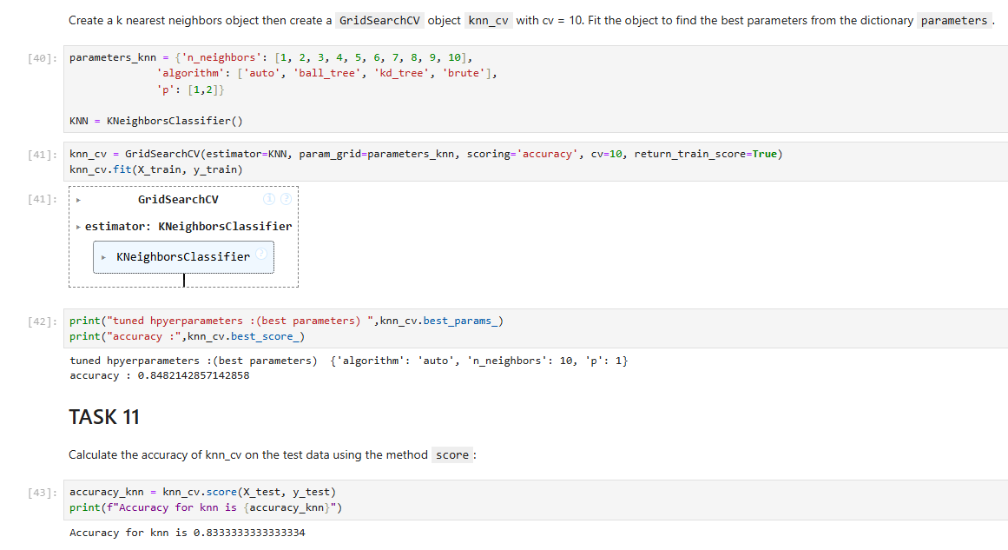
Classification Accuracy - Knn

Slide 41
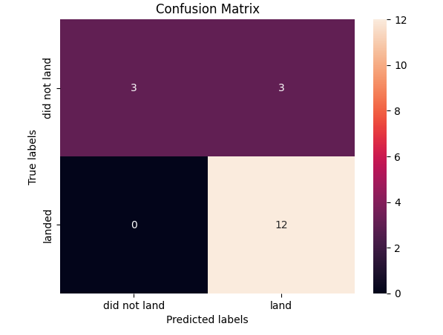
Confusion Matrix of best performing model

Slide 42


